Slide 1
Data Base Management System
unit-1
Prepared by
MEGHA J
&
VINAY

Slide 2
Outline
Data Models and Their Categories
History of Data Models
Schemas, Instances, and States
Three-Schema Architecture
Data Independence
DBMS Languages and Interfaces
Slide - ‹#›
Notes:
‹#›

Slide 3
Data Models
Data Model:
A set of concepts to describe the structure of a database, the operations for manipulating these structures, and certain constraints that the database should obey.
Data Model Structure and Constraints:
Constructs are used to define the database structure
Constructs typically include elements (and their data types) as well as groups of elements (e.g. entity, record, table), and relationships among such groups
Constraints specify some restrictions on valid data; these constraints must be enforced at all times
Slide 2- ‹#›
Notes:
‹#›

Slide 4
Data Models (continued)
Data Model Operations:
These operations are used for specifying database retrievals and updates by referring to the constructs of the data model.
Operations on the data model may include basic model operations (e.g. generic insert, delete, update) and user-defined operations (e.g. compute_student_gpa, update_inventory)
Slide 2- ‹#›
Notes:
‹#›

Slide 5
Categories of Data Models
Conceptual (high-level, semantic) data models:
Provide concepts that are close to the way many users perceive data.
(Also called entity-based or object-based data models.)
Physical (low-level, internal) data models:
Provide concepts that describe details of how data is stored in the computer. These are usually specified in an ad-hoc manner through DBMS design and administration manuals
Implementation (representational) data models:
Provide concepts that fall between the above two, used by many commercial DBMS implementations (e.g. relational data models used in many commercial systems).
Slide 2- ‹#›
Notes:
‹#›

Slide 6
Schemas versus Instances
Database Schema:
The description of a database.
Includes descriptions of the database structure, data types, and the constraints on the database.
Schema Diagram:
An illustrative display of (most aspects of) a database schema.
Schema Construct:
A component of the schema or an object within the schema, e.g., STUDENT, COURSE.
Slide 2- ‹#›
Notes:
‹#›

Slide 7
Schemas versus Instances
Database State:
The actual data stored in a database at a particular moment in time. This includes the collection of all the data in the database.
Also called database instance (or occurrence or snapshot).
The term instance is also applied to individual database components, e.g. record instance, table instance, entity instance
Slide 2- ‹#›
Notes:
‹#›

Slide 8
Database Schema vs. Database State
Database State:
Refers to the content of a database at a moment in time.
Initial Database State:
Refers to the database state when it is initially loaded into the system.
Valid State:
A state that satisfies the structure and constraints of the database.
Slide 2- ‹#›
Notes:
‹#›

Slide 9
Database Schema vs. Database State (continued)
Distinction
The database schema changes very infrequently.
The database state changes every time the database is updated.
Schema is also called intension.
State is also called extension.
Slide 2- ‹#›
Notes:
‹#›

Slide 10
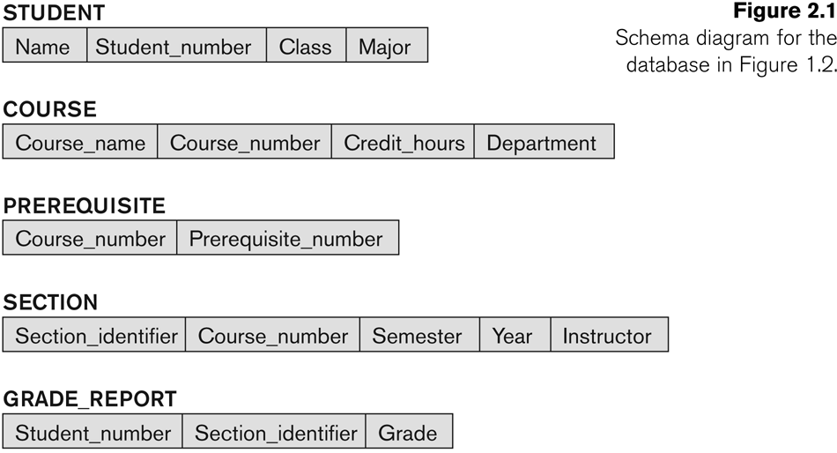
Example of a Database Schema
Slide 2- ‹#›

Slide 11
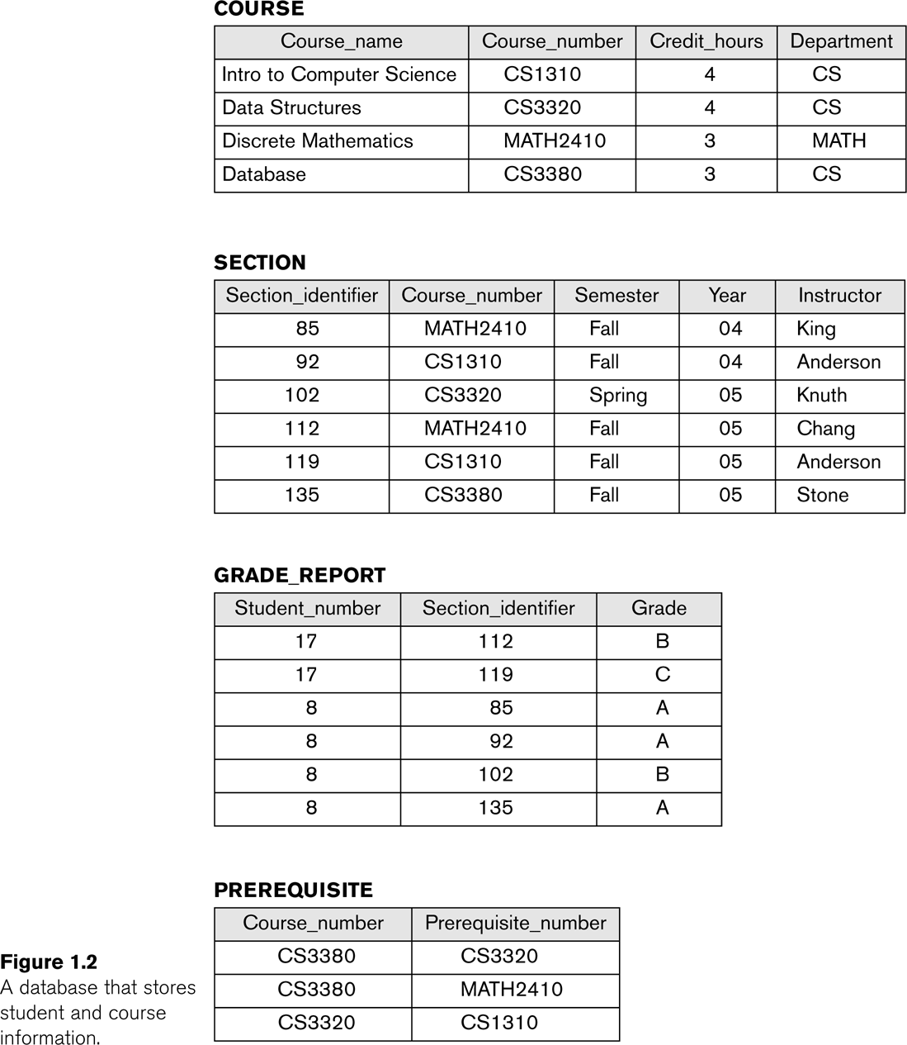
Example of a database state
Slide 2- ‹#›

Slide 12
Three-Schema Architecture
Proposed to support DBMS characteristics of:
Program-data independence.
Support of multiple views of the data.
Not explicitly used in commercial DBMS products, but has been useful in explaining database system organization
Slide 2- ‹#›
Notes:
‹#›

Slide 13
Three-Schema Architecture
Defines DBMS schemas at three levels:
Internal schema at the internal level to describe physical storage structures and access paths (e.g indexes).
Typically uses a physical data model.
Conceptual schema at the conceptual level to describe the structure and constraints for the whole database for a community of users.
Uses a conceptual or an implementation data model.
External schemas at the external level to describe the various user views.
Usually uses the same data model as the conceptual schema.
Slide 2- ‹#›
Notes:
‹#›

Slide 14
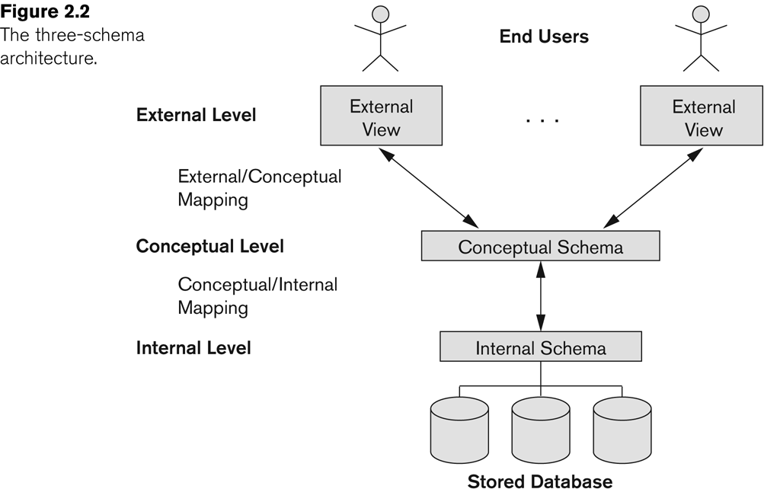
The three-schema architecture
Slide 2- ‹#›

Slide 15
Three-Schema Architecture
Mappings among schema levels are needed to transform requests and data.
Programs refer to an external schema, and are mapped by the DBMS to the internal schema for execution.
Data extracted from the internal DBMS level is reformatted to match the user’s external view (e.g. formatting the results of an SQL query for display in a Web page)
Slide 2- ‹#›
Notes:
‹#›

Slide 16
Data Independence
Logical Data Independence:
The capacity to change the conceptual schema without having to change the external schemas and their associated application programs.
Physical Data Independence:
The capacity to change the internal schema without having to change the conceptual schema.
For example, the internal schema may be changed when certain file structures are reorganized or new indexes are created to improve database performance
Slide 2- ‹#›
Notes:
‹#›

Slide 17
Data Independence (continued)
When a schema at a lower level is changed, only the mappings between this schema and higher-level schemas need to be changed in a DBMS that fully supports data independence.
The higher-level schemas themselves are unchanged.
Hence, the application programs need not be changed since they refer to the external schemas.
Slide 2- ‹#›
Notes:
‹#›

Slide 18
DBMS Languages
Data Definition Language (DDL)
Data Manipulation Language (DML)
High-Level or Non-procedural Languages: These include the relational language SQL
May be used in a standalone way or may be embedded in a programming language
Low Level or Procedural Languages:
These must be embedded in a programming language
Slide 2- ‹#›
Notes:
‹#›

Slide 19
DBMS Languages
Data Definition Language (DDL):
Used by the DBA and database designers to specify the conceptual schema of a database.
In many DBMSs, the DDL is also used to define internal and external schemas (views).
In some DBMSs, separate storage definition language (SDL) and view definition language (VDL) are used to define internal and external schemas.
SDL is typically realized via DBMS commands provided to the DBA and database designers
Slide 2- ‹#›
Notes:
‹#›

Slide 20
DBMS Languages
Data Manipulation Language (DML):
Used to specify database retrievals and updates
DML commands (data sublanguage) can be embedded in a general-purpose programming language (host language), such as COBOL, C, C++, or Java.
A library of functions can also be provided to access the DBMS from a programming language
Alternatively, stand-alone DML commands can be applied directly (called a query language).
Slide 2- ‹#›
Notes:
‹#›

Slide 21
Types of DML
High Level or Non-procedural Language:
For example, the SQL relational language
Are “set”-oriented and specify what data to retrieve rather than how to retrieve it.
Also called declarative languages.
Low Level or Procedural Language:
Retrieve data one record-at-a-time;
Constructs such as looping are needed to retrieve multiple records, along with positioning pointers.
Slide 2- ‹#›
Notes:
‹#›

Slide 22
DBMS Programming Language Interfaces
Programmer interfaces for embedding DML in a programming languages:
Embedded Approach: e.g embedded SQL (for C, C++, etc.), SQLJ (for Java)
Procedure Call Approach: e.g. JDBC for Java, ODBC for other programming languages
Database Programming Language Approach: e.g. ORACLE has PL/SQL, a programming language based on SQL; language incorporates SQL and its data types as integral components
Slide 2- ‹#›
Notes:
‹#›

Slide 23
Other DBMS Interfaces
Speech as Input and Output
Web Browser as an interface
Parametric interfaces, e.g., bank tellers using function keys.
Interfaces for the DBA:
Creating user accounts, granting authorizations
Setting system parameters
Changing schemas or access paths
Slide 2- ‹#›
Notes:
‹#›

Slide 24
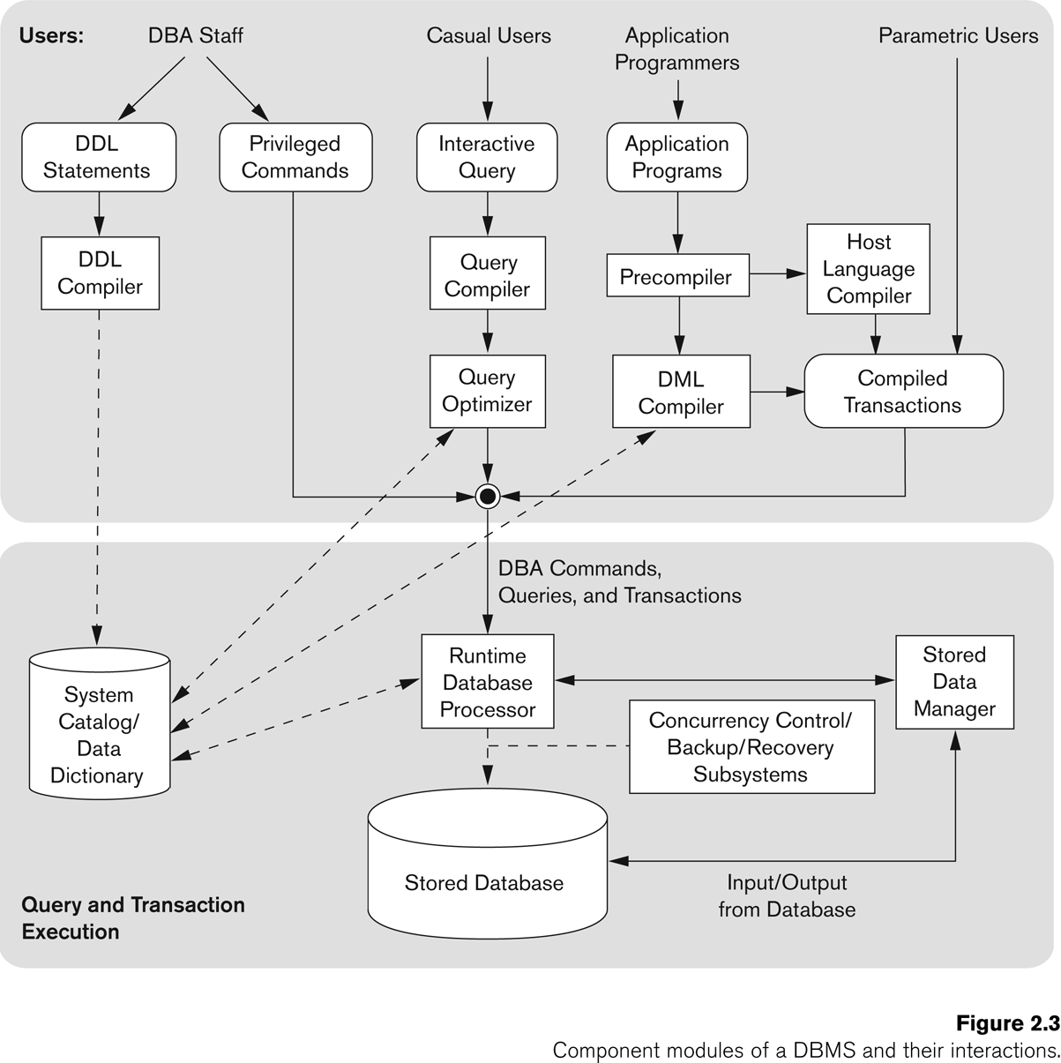
Typical DBMS Component Modules
Slide 2- ‹#›

Slide 25
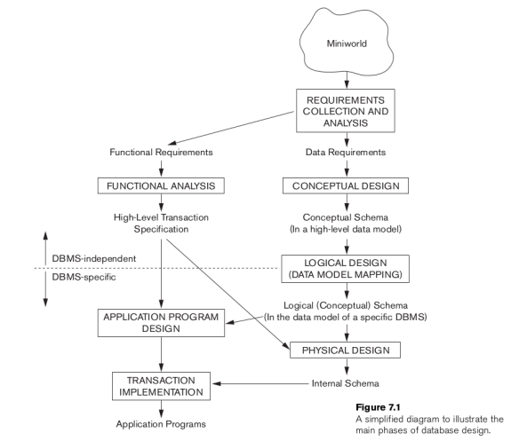
CONCEPTUAL DATA MODELLING USING ENTITIES AND RELATIONSHIPS

Slide 26
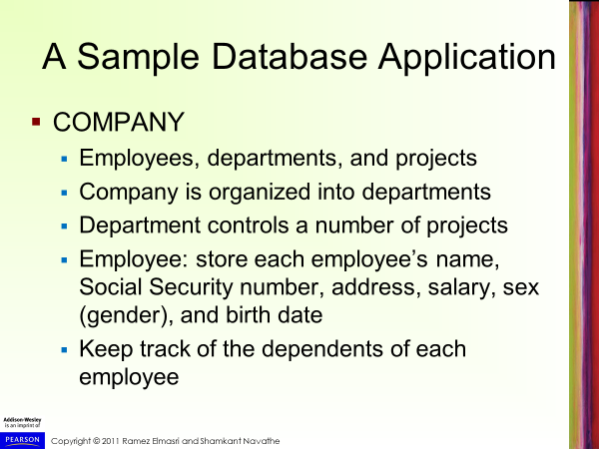

Slide 27
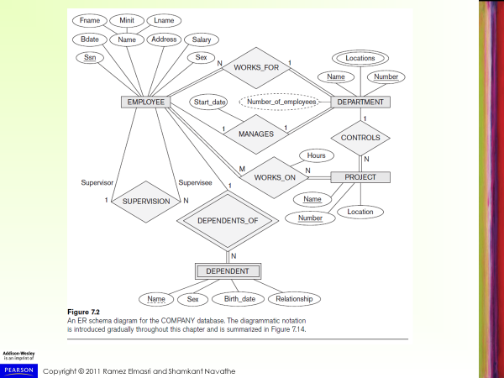

Slide 28
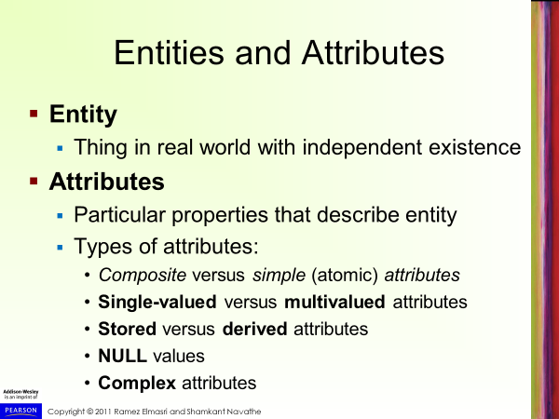

Slide 29
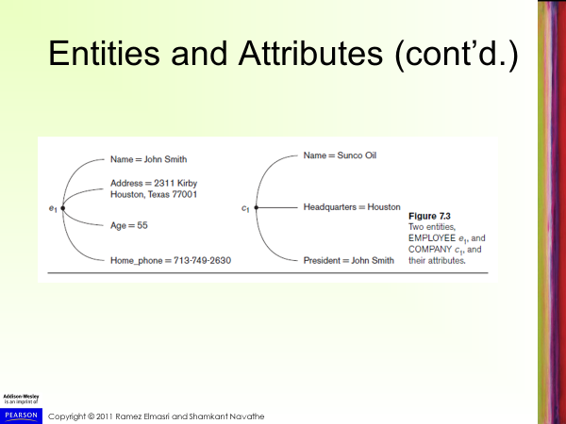

Slide 30
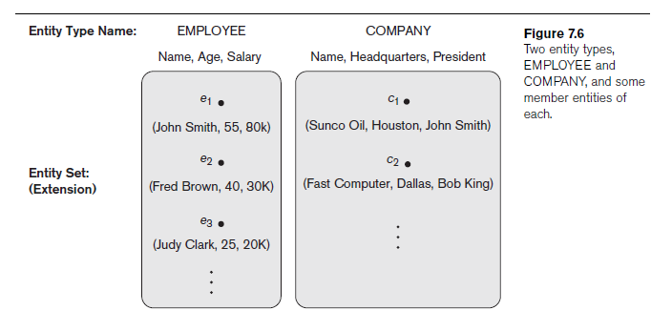
Entity Types, Entity Sets, Keys, and Value Sets
Entity type
Collection (or set) of entities that have the same attributes

Slide 31
Entity Types, Entity Sets, Keys, and Value Sets
Entity type
Collection (or set) of entities that have the same attributes

Slide 32
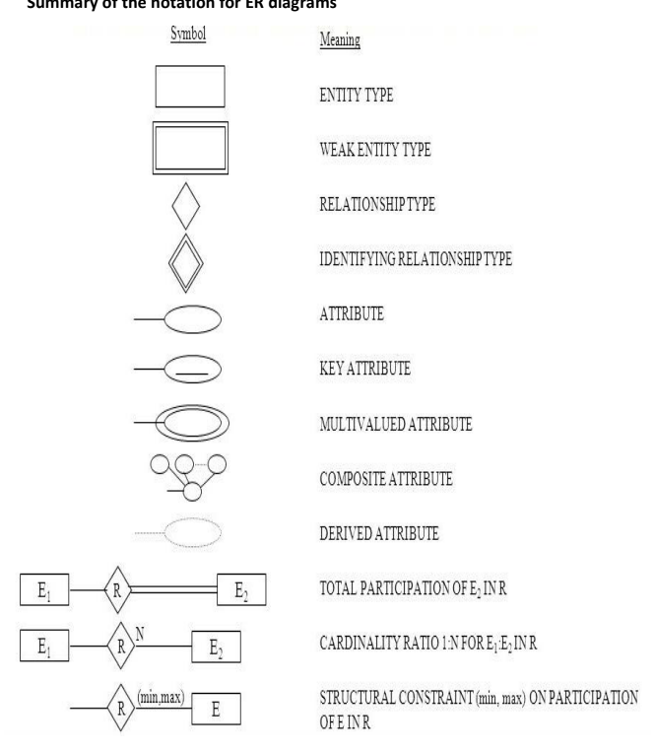

Slide 33
Entity Types, Entity Sets, Keys, and Value Sets (cont’d.)
Key or uniqueness constraint
Attributes whose values are distinct for each individual entity in entity set
Key attribute
Uniqueness property must hold for every entity set of the entity type
Value sets (or domain of values)
Specifies set of values that may be assigned to that attribute for each individual entity

Slide 34
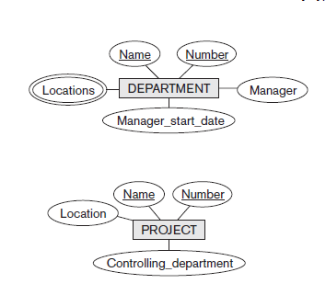
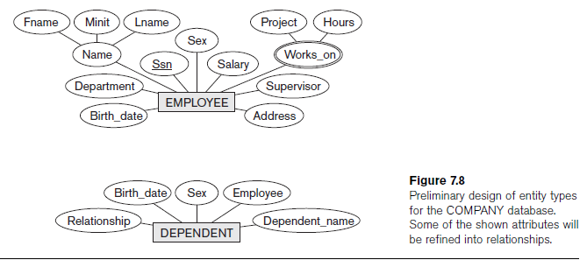
Initial Conceptual Design of the COMPANY Database

Slide 35
Relationship Types, Relationship Sets, Roles, and Structural Constraints
Relationship
When an attribute of one entity type refers to another entity type
Represent references as relationships not attributes

Slide 36
Relationship Types, Sets, and Instances
Relationship type R among n entity types E₁, E₂, ..., E_{n}
Defines a set of associations among entities from these entity types
Relationship instances r_{i}
Each r_{i} associates n individual entities (e₁, e₂, ..., e_{n})
Each entity e_{j} in r_{i} is a member of entity set E_{j}

Slide 37
Relationship Degree
Degree of a relationship type
Number of participating entity types
Binary, ternary
Relationships as attributes
Think of a binary relationship type in terms of attributes

Slide 38
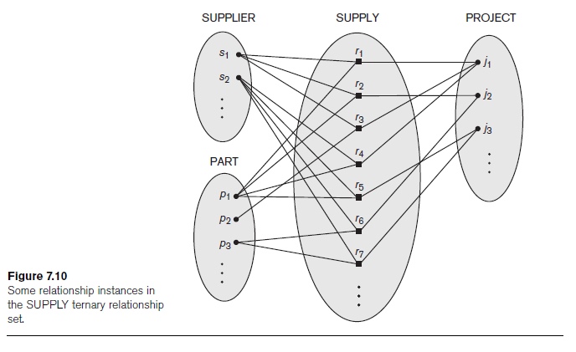

Slide 39
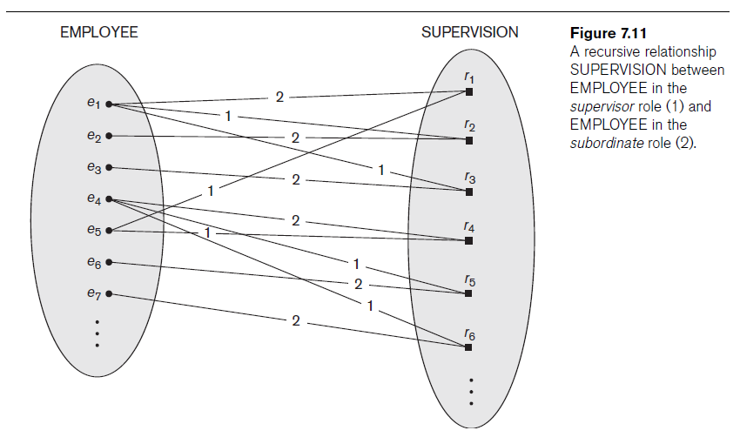

Slide 40
Role Names and Recursive Relationships
Role names and recursive relationships
Role name signifies role that a participating entity plays in each relationship instance
Recursive relationships
Same entity type participates more than once in a relationship type in different roles
Must specify role name

Slide 42
Constraints on Binary Relationship Types
Cardinality ratio for a binary relationship
Specifies maximum number of relationship instances that entity can participate in
Participation constraint
Specifies whether existence of entity depends on its being related to another entity
Types: total and partial

Slide 43
Attributes of Relationship Types
Attributes of 1:1 or 1:N relationship types can be migrated to one entity type
For a 1:N relationship type
Relationship attribute can be migrated only to entity type on N-side of relationship
For M:N relationship types
Some attributes may be determined by combination of participating entities
Must be specified as relationship attributes

Slide 44
Weak Entity Types
Do not have key attributes of their own
Identified by being related to specific entities from another entity type
Identifying relationship
Relates a weak entity type to its owner
Always has a total participation constraint

Slide 45
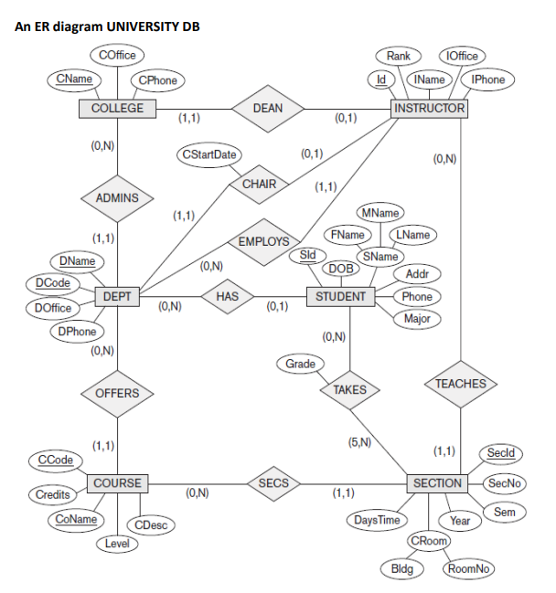

Slide 46
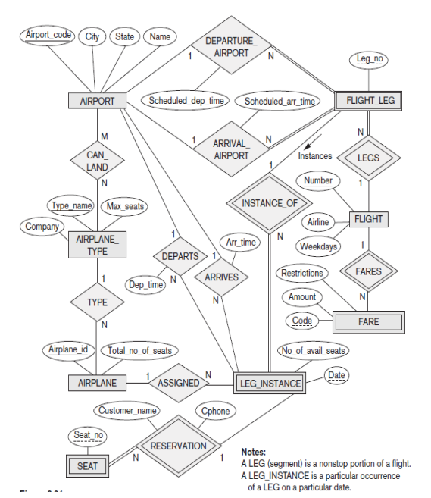

Slide 47
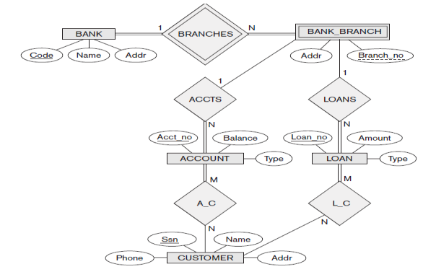
ER DIAGRAM FOR BANK

Slide 48
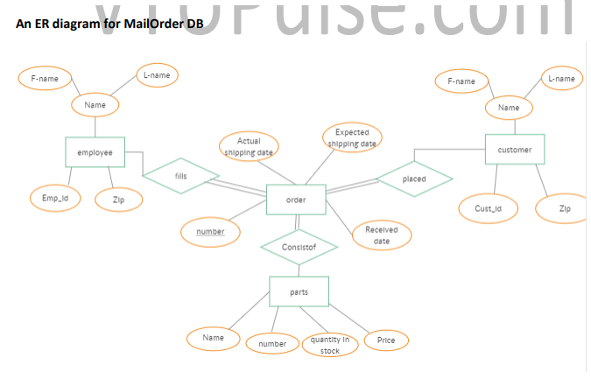
ER DIAGRAM FOR MAIL ORDER

Slide 49
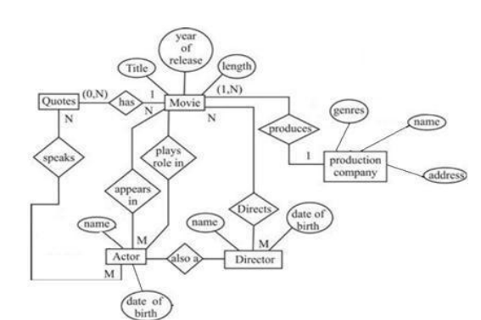
ER DIAGRAM FOR MOVIE

